Slide 1
Making this resource work for you
Prior to teaching this lesson, please refer to the ‘Unit Overview and Planning Document’.
Further guidance on planning Science Mastery lessons can be found in the detailed planning guidance document.
Refer to the ‘notes’ section on each slide for useful information, including suggested expositions, pedagogical content knowledge, suggested questions, answers and more. Consider using presenter mode so you can see this guidance throughout the lesson.
The introduction slides can be adapted to suit your teaching style and the needs of your class.
Before the lesson, adapt the fix-it slide to address any misconceptions identified in the previous lesson’s exit ticket.
Choose from the suggested activities to suit your class. The intention is not that you complete all of these, but that you select those which ones are most appropriate for your students. It may be appropriate to further adapt activities for your students.
These lessons are designed to occupy approximately 1 hour. To adapt for a shorter or longer lesson duration we advise you to adapt the activity section accordingly.
Please consider using the final slide to send feedback about this lesson or examples of PowerPoints that you have adapted to our design team. Your feedback is used to improve Science Mastery for all of our teachers and students. We appreciate all suggestions and comments.
Thank you for reading!
The Science Mastery Team

Slide 2

Taking it Further: Carboxylic Acids
Answer the questions below.
State the two methods of producing ethanol.
Name the functional group found in alcohols.
Describe the conditions needed for the hydration of ethene.
State the general formula of the alkanes.
State the pH range of an acid.
Through fermentation or by hydration of ethene.
Hydroxyl group (OH)
A high temperature (300 ºC), a catalyst (phosphoric acid), and 60-70 atm of pressure
C_{n}H_{2n+2}
pH 1-7
Notes:
Big idea: Reactions rearrange matter
Foundation: State the formula of hydrochloric acid.
Stretch: Explain what it means for an acid to ionise.
Answers:
Foundation: HCl
Stretch: To separate/dissociate into its ions in solution.

Slide 3
Taking it Further: Carboyxlic Acids
Do Now:
State the two methods of producing ethanol.
Name the functional group found in alcohols.
Describe the conditions needed for the hydration of ethene.
State the general formula of the alkanes.
State the pH range of an acid.
Drill:
Describe three ways of determining if a substance is an acid or an alkali.
Name some common acids.
Identify the ion that makes substances acidic.
Notes:
Drill answers:
(universal) indicator, pH probe or litmus paper
Hydrochloric acid, sulfuric acid, nitric acid, carbonic acid, ethanoic acid, citric acid
Hydrogen (H⁺)

Slide 4
Taking it Further: Carboxylic Acids
Read Now:
Carboxylic acids are another homologous series of organic (carbon-containing compounds). As with other organic compounds, the carboxylic acids have many different uses for humans, and we use many of them without realising it. One of the most abundant carboxylic acids is ethanoic acid, which is sometimes also called acetic acid. This acid is the main component of vinegar (other than water) and is used to flavour different foods. Often ethanoic acid used in vinegar is made from a double fermentation process, where ethanol is made from plant sugars using yeast, then fermented again using bacteria to produce ethanoic acid.
Give an example of a carboxylic acid.
Give the other name for ethanoic acid.
Give one use for ethanoic acid.
Describe how ethanoic acid is made.

Slide 5

C5.1.10
15/08/2024
Taking it Further: Carboxylic Acids
C5.1.1 Prior Knowledge Review
C5.1.2 Crude Oil and Hydrocarbons
C5.1.3 Fractional Distillation
C5.1.4 Combustion of Hydrocarbons
C5.1.5 Cracking
C5.1.6 Taking it Further: Alkenes
C5.1.7 Taking it Further: Alcohols
C5.1.8 Taking it Further: Producing Ethanol by Fermentation
C5.1.9 Taking it Further: Producing Ethanol from Ethene
C5.1.10 Taking it Further: Carboxylic Acids
C5.1.11 Taking it Further: Esters
C5.1.12 Polymers
C5.1.13 Taking it Further: Addition Polymerisation
C5.1.14 Taking it Further: Condensation Polymerisation
C5.1.15 Taking it Further: Naturally Occurring Polymers
Notes:
Big Idea: Structure Determines Properties
In this lesson, students will look at the homologous series of carboxylic acids. This will link in with previous lessons, where students look at functional groups, saturation vs unsaturation and reactions of organic compounds.
Suggested Hook:
Where do we find acids in everyday products? What kind of acids are they?

Slide 6

Following this lesson, students will be able to:
Identify the functional group found in carboxylic acids
Draw structural formulae of carboxylic acids
Write chemical equations for reactions of carboxylic acids
Key Words:
carboxylic acid
carboxyl
-COOH
strong
weak
concentrated
dilute
Notes:
Guidance:
See unit overview document and planning guidance to see how these objectives are typically assessed at GCSE, including examples of what students should be able to do following this lesson.
Planning for different needs:
The learning objectives given on this slide are suggested based on the most common requirements for exams, however they can be adapted based on the needs of different classes.
For best practice, the unit preparation booklet should be used to determine the appropriate focus of lessons within the unit.
While it is not possible to explicitly split content into levelled grades, we recommend that lesson objectives can be classified as critical, core or stretch.
Critical: the content or skill is essential for all students to be able to progress.
Core: the content or skill is important for students to progress, but other opportunities may be available to revisit it.
Stretch: the content or skill may not be essential for all students but is important for students aiming for the highest grades.
Key skill: this is a crucial skill being developed in this unit as part of the skill mapping
C5.1.10 Lesson Objectives:
Critical: Identify the functional group found in carboxylic acids
Critical: Draw structural formulae of carboxylic acids
Core: Write chemical equations for reactions of carboxylic acids

Slide 7
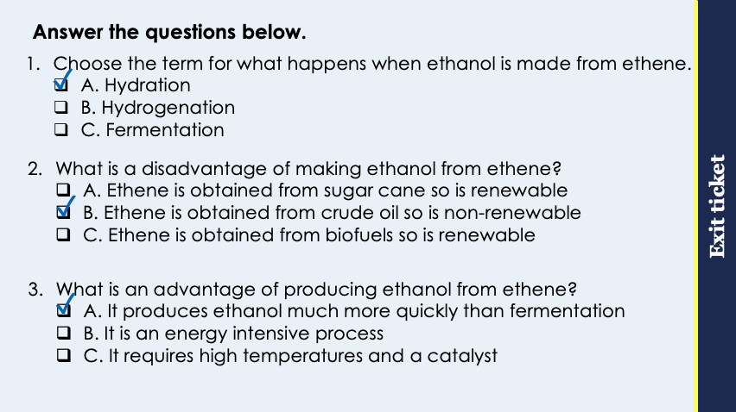
This is the fix-it portion of the lesson
The fix-it is an opportunity to respond to gaps in knowledge, especially those identified by the pre-unit quiz.
The teacher should customise this slide as needed, to facilitate
reteach, explanation, demonstration or modelling of ideas and concepts that students have not yet grasped or have misunderstood.
practise answering specific questions or of key skills.
redrafting or improving previous work.
Notes:
Purpose: to spend time on any gaps identified in previous learning from previous exit ticket.
Guidance from previous exit ticket:
Q1. Answer: A
If students answer B, they have made the common mistake of confusing hydration and hydrogenation. If students answer C, they are not clear that ethene is not involved in fermentation. To fix-it, review the steps involved in each method of ethanol production.
Q2. Answer: B
If students answer A, they have confused the raw material for fermentation and hydration. If students answer C, they are not clear on what a biofuel is. To fix it, review the advantages and disadvantages of each method of ethanol production.
Q3. Answer: A
If students answer B, they have identified a disadvantage rather than an advantage. To fix it, review why energy intensity would be a disadvantage. If students answer C, they have simply stated the conditions rather than an advantage, which is a common mistake when answering exam questions on this topic. To fix it, review the advantages and disadvantages of each method of ethanol production.

Slide 8
Carboxylic Acids
The carboxylic acids are another homologous series.
They contain a functional group called a carboxyl group, which can be written as -COOH.
Methanoic acid
Propanoic acid
H
H
C₂H₅COOH
O
H
C
O
H
C
C
C
O
H
HCOOH
O
H
H
H
Butanoic acid
Ethanoic acid
H
H
H
H
O
O
H
C
C
H
C
C
C
C
O
H
O
H
CH₃COOH
C₃H₇COOH
H
H
H
H
Notes:
Suggested exposition:
We have already met different homologous series: the alkanes, the alkenes and the alcohols.
Now we’re going to look at another homologous series: the carboxylic acids.
The carboxylic acids all contain a carboxyl functional group, which can be written as -COOH.
Animate methanoic acid.
As with the other homologous series, we use the same naming conventions depending on the number of carbon atoms in the molecule.
So methanoic acid is the first carboxylic acid. It has to contain the function group -COOH, which contains a carbon atom. This means that methanoic acid only has an additional hydrogen atom.
How many bonds does carbon have to make?
4
How many bonds does oxygen have to make?
2
Within the carboxyl functional group, there is a double bond between the carbon and one of the oxygen atoms.
Let’s look at the first four carboxylic acids. Animate the other carboxylic acids.
They each have the -COOH carboxyl functional group.
Let’s use the structural formulae to determine the chemical formulae of each of the carboxylic acids.
As with the alcohols, we write chemical formulae of the carboxylic acids with the functional group at the end so they can be identified.
Using this information, how would we write the formula of methanoic acid?
HCOOH
For the other carboxylic acids, as with the alcohols, we write the formula of the rest of the chain followed by the functional group.

Slide 9
What is the general formula for the carboxylic acids?
The general formula of the carboxylic acids can be written as:
C_{n}H_{2n+1}COOH, where n is the number of carbon atoms in the molecule minus 1
or C_{n}H_{2n}O₂)
Methanoic acid
Propanoic acid
H
H
C₂H₅COOH
O
H
C
O
H
C
C
C
O
H
HCOOH
O
H
H
H
Butanoic acid
Ethanoic acid
H
H
H
H
O
O
H
C
C
H
C
C
C
C
O
H
O
H
CH₃COOH
C₃H₇COOH
H
H
H
H

Slide 10

Properties of Carboxylic Acids
Like the other homologous series, carboxylic acids show similar physical and chemical properties.
The carboxyl functional group is responsible for the chemical properties.
Carboxylic acids are weak acids, which dissolve in water to form acidic solutions with a pH of less than 7.
Vinegar is a dilute solution of ethanoic acid.
Carboxylic acids can be formed through the oxidation of alcohols by an oxidising agent.
Notes:
Suggested exposition:
Like all homologous series, the carboxylic acids have the same general formula, their chemical formulae differ by CH2 from neighbouring compounds. They also have a pattern in physical properties, such as boiling points, which generally increase with the size of a molecule.
Carboxylic acids also have similar chemical properties, due to the carboxyl functional group.
Carboxylic acids are weak acids. They dissolve in water to form acidic solutions with pH values less than 7.
What colour would universal indicator turn when added to a carboxylic acid?
Orange/red
(HT) What is a weak acid?
An acid that only partially ionises in solution.
This means their solutions do not contain many hydrogen ions compared to a strong acid (such as hydrochloric acid) of the same concentration.
Carboxylic acids can be formed through the oxidation (without combustion) of alcohols by an oxidising agent. For example, ethanol can be oxidised to form ethanoic acid if it is exposed to oxygen or air. This is what happens when alcoholic drinks such as wine go off and start to have a vinegary taste.
Image from pixabay

Slide 11
Reactions of Carboxylic Acids
Like other acids, carboxylic acids react with metals and metal compounds.
Acid + metal →
salt + hydrogen
Acid + alkali →
salt + water
Acid + base →
salt + water
Acid + metal carbonate →
salt + water + carbon dioxide
Notes:
Suggested exposition:
Like all acids, carboxylic acids react with metals and other metal compounds.
Let’s complete the general equations.
What are the products of an acid reacting with a metal?
Salt and hydrogen
What are the products of an acid reacting with an alkali?
Salt and water
What are the products of an acid reacting with a base?
Salt and water
What is the difference between an alkali and a base?
An alkali is a soluble base.
What are the products of an acid reacting with a metal carbonate?
Salt, water and carbon dioxide
Note: it can be useful to model a couple of examples of naming salts from given reactants with students. They should be familiar with naming salts from Y8 to Y10, but a reminder can be helpful.

Slide 12




Which statements do you agree with?
Methanoic acid has the formula CH₃COOH
The function group in carboxylic acids is a carboxylic group
Carboyxlic acids contain a C=C double bond
Carboxylic acids are weak acids
Notes:
Suggested points:
Blue: incorrect - this must be written as carboxyl, carboxylic will not be accepted by examiners
Yellow: incorrect - this is the most common mistake with carboxylic acids
Green: incorrect, they contain a C=O double bond
Pink: correct
Suggested guidance:
Talk tasks can be used in a variety of ways to suit the particular needs of the students you are teaching. Through exchanging views with others, students develop their understanding of the science beyond what could be achieved individually.
Science classrooms that successfully integrate talk have the following features:
Science talk is a regular feature of lessons and is woven into classroom activities.
Students are paired or grouped strategically by the teacher to ensure productive interaction. This might take into consideration the students’ proficiency of the English language, how encouraging they might be to peers and their attainment in the topic. It’s a good idea to consider these pairings in the class seating plan.
Students are encouraged and supported to talk, but are not forced to talk.
The teacher should take on the role of a facilitator, engaging with conversations where necessary and encouraging or steering the conversation where needed.
Students are encouraged to use the language they have to express their ideas (e.g., everyday language, imperfect English, native language), but also to incorporate science specific terminology where this is more accurate or has been taught.
6. Scientifically inaccurate ideas are not dismissed by the partner or teacher; open discussion and further investigation are relied on to help students construct ideas that support them to progress in their scientific understanding.
7. Guidelines for behaviour during talk tasks are explicit and frequently reviewed. Rules for students might be:
Listen carefully to your partner
Take turns talking.
Speak one at a time, without interrupting.
Politely agree or disagree and explain why.
Politely point out if your partner has used a scientific word incorrectly, if they have explained the science incorrectly, or if there is a more accurate way to describe something.
If confused, ask questions.
Stay focused on the discussion topic.
Respond to one another.

Slide 13

Can you explain the difference between these two terms?
Dilute acid
Concentrated acid
Notes:
Suggested points:
A dilute acid contains a small number of acid molecules per unit volume, and lots of water molecules
A concentrated acid contains a large number of acid molecules per unit volume and fewer water molecules
Suggested guidance:
Talk tasks can be used in a variety of ways to suit the particular needs of the students you are teaching. Through exchanging views with others, students develop their understanding of the science beyond what could be achieved individually.
Science classrooms that successfully integrate talk have the following features:
Science talk is a regular feature of lessons and is woven into classroom activities.
Students are paired or grouped strategically by the teacher to ensure productive interaction. This might take into consideration the students’ proficiency of the English language, how encouraging they might be to peers and their attainment in the topic. It’s a good idea to consider these pairings in the class seating plan.
Students are encouraged and supported to talk, but are not forced to talk.
The teacher should take on the role of a facilitator, engaging with conversations where necessary and encouraging or steering the conversation where needed.
Students are encouraged to use the language they have to express their ideas (e.g., everyday language, imperfect English, native language), but also to incorporate science specific terminology where this is more accurate or has been taught.
6. Scientifically inaccurate ideas are not dismissed by the partner or teacher; open discussion and further investigation are relied on to help students construct ideas that support them to progress in their scientific understanding.
7. Guidelines for behaviour during talk tasks are explicit and frequently reviewed. Rules for students might be:
Listen carefully to your partner
Take turns talking.
Speak one at a time, without interrupting.
Politely agree or disagree and explain why.
Politely point out if your partner has used a scientific word incorrectly, if they have explained the science incorrectly, or if there is a more accurate way to describe something.
If confused, ask questions.
Stay focused on the discussion topic.
Respond to one another.

Slide 14
(HT) Can you explain the difference between these two terms?
Strong acid
Weak acid
Notes:
Suggested points:
A strong acid ionises fully in solution
A weak acid only partially ionises in solution
Hydrochloric, nitric and sulfuric acid are all strong acids
Ethanoic acid and the carboxylic acids are weak acids
Suggested guidance:
Talk tasks can be used in a variety of ways to suit the particular needs of the students you are teaching. Through exchanging views with others, students develop their understanding of the science beyond what could be achieved individually.
Science classrooms that successfully integrate talk have the following features:
Science talk is a regular feature of lessons and is woven into classroom activities.
Students are paired or grouped strategically by the teacher to ensure productive interaction. This might take into consideration the students’ proficiency of the English language, how encouraging they might be to peers and their attainment in the topic. It’s a good idea to consider these pairings in the class seating plan.
Students are encouraged and supported to talk, but are not forced to talk.
The teacher should take on the role of a facilitator, engaging with conversations where necessary and encouraging or steering the conversation where needed.
Students are encouraged to use the language they have to express their ideas (e.g., everyday language, imperfect English, native language), but also to incorporate science specific terminology where this is more accurate or has been taught.
6. Scientifically inaccurate ideas are not dismissed by the partner or teacher; open discussion and further investigation are relied on to help students construct ideas that support them to progress in their scientific understanding.
7. Guidelines for behaviour during talk tasks are explicit and frequently reviewed. Rules for students might be:
Listen carefully to your partner
Take turns talking.
Speak one at a time, without interrupting.
Politely agree or disagree and explain why.
Politely point out if your partner has used a scientific word incorrectly, if they have explained the science incorrectly, or if there is a more accurate way to describe something.
If confused, ask questions.
Stay focused on the discussion topic.
Respond to one another.

Slide 15
Determine whether each of these statements is true or false
Methanoic acid has the formula HCOOH
Propanoic acid contains four carbon atoms
The functional group of carboxylic acids is the hydroxyl group
Carboxylic acids are weak acids
Carboxylic acids react with alkalis to form salts, water and hydrogen
True
False
False
True
False

Slide 16
Drill
State the chemical formula of methanoic acid.
State the chemical formula of ethanoic acid.
Name the functional group of the carboxylic acids.
State the formula of the functional groups of the carboxylic acids.
State the pH values of solutions containing dissolved carboxylic acids.
State whether carboxylic acids are strong or weak acids.
State the products formed when a carboxylic acid reacts with a metal carbonate.
Write a general equation for the reactions between carboxylic acids and metal carbonates.
Notes:
Purpose: This is a knowledge drill. The purpose of this is to check that the critical knowledge is secure before pupils move onto independent practice.
Suggested guidance: There are a range of ways this could be done depending on time and ability range of the class:
Mini whiteboards
As full sentences in exercise books
As short answers in exercise books
In the pupil workbook
As pair talk
As cold call

Slide 17
Drill answers
HCOOH
CH₃COOH
Carboxyl group
-COOH
Less than 7
Weak acids
Salt, water and carbon dioxide
Carboxylic acid + metal carbonate → salt + water + carbon dioxide
Notes:
Purpose: This is a knowledge drill. The purpose of this is to check that the critical knowledge is secure before pupils move onto independent practice.
Suggested guidance: There are a range of ways this could be done depending on time and ability range of the class:
Mini whiteboards
As full sentences in exercise books
As short answers in exercise books
In the pupil workbook
As pair talk
As cold call

Slide 18
I: Reactions of Carboxylic Acids
Calcium carbonate reacts with ethanoic acid.
Draw the structural formula for ethanoic acid.
H
O
H
C
C
O
H
H
State the chemical formula for ethanoic acid.
CH₃COOH
What products would be made in a reaction between a carboxylic acid and a metal carbonate?
A salt, water and carbon dioxide
Write a word equation for this reaction.
Calcium carbonate + ethanoic acid → calcium ethanoate + water + carbon dioxide
Notes:
Purpose: The I-We-You section aims to support pupils to build skills that they most commonly need when answering questions associated with this knowledge in the assessment. This section is also used to interleave other content we expect pupils to know at this stage of their education in order that they build a big picture of the science they are learning.
For the ‘I’ activity, the teacher should model how to answer the question. They can do this by narrating their thinking process aloud, and making links to learning earlier in the lesson explicit.
For the ‘we’ activity, the teacher and students work though a similar example together, in order to prepare students to be able to answer a similar question independently.
Opportunities for the ‘you’ activity – independent practise – occur in the activity portion of the lesson once the student is secure enough to process independently.

Slide 19
We: Reactions of Carboxylic Acids
Sodium carbonate reacts with propanoic acid.
Draw the structural formula for propanoic acid.
H
H
O
H
C
C
C
O
H
H
H
State the chemical formula for propanoic acid.
C₂H₅COOH
What products would be made in a reaction between a carboxylic acid and a metal carbonate?
A salt, water and carbon dioxide
Write a word equation for this reaction.
Sodium carbonate + propanoic acid → sodium propanoate + water + carbon dioxide
Notes:
Purpose: The I-We-You section aims to support pupils to build skills that they most commonly need when answering questions associated with this knowledge in the assessment. This section is also used to interleave other content we expect pupils to know at this stage of their education in order that they build a big picture of the science they are learning.
For the ‘I’ activity, the teacher should model how to answer the question. They can do this by narrating their thinking process aloud, and making links to learning earlier in the lesson explicit.
For the ‘we’ activity, the teacher and students work though a similar example together, in order to prepare students to be able to answer a similar question independently.
Opportunities for the ‘you’ activity – independent practise – occur in the activity portion of the lesson once the student is secure enough to process independently.

Slide 20
You: Reactions of Carboxylic Acids
Magnesium carbonate reacts with butanoic acid.
Draw the structural formula for butanoic acid.
H
H
H
O
H
C
C
C
C
O
H
H
H
H
State the chemical formula for butanoic acid.
C₃H₇COOH
What products would be made in a reaction between a carboxylic acid and a metal carbonate?
A salt, water and carbon dioxide
Write a word equation for this reaction.
Magnesium carbonate + butanoic acid → magnesium ethanoate + water + carbon dioxide
Notes:
Purpose: The I-We-You section aims to support pupils to build skills that they most commonly need when answering questions associated with this knowledge in the assessment. This section is also used to interleave other content we expect pupils to know at this stage of their education in order that they build a big picture of the science they are learning.
For the ‘I’ activity, the teacher should model how to answer the question. They can do this by narrating their thinking process aloud, and making links to learning earlier in the lesson explicit.
For the ‘we’ activity, the teacher and students work though a similar example together, in order to prepare students to be able to answer a similar question independently.
Opportunities for the ‘you’ activity – independent practise – occur in the activity portion of the lesson once the student is secure enough to process independently.

Slide 21
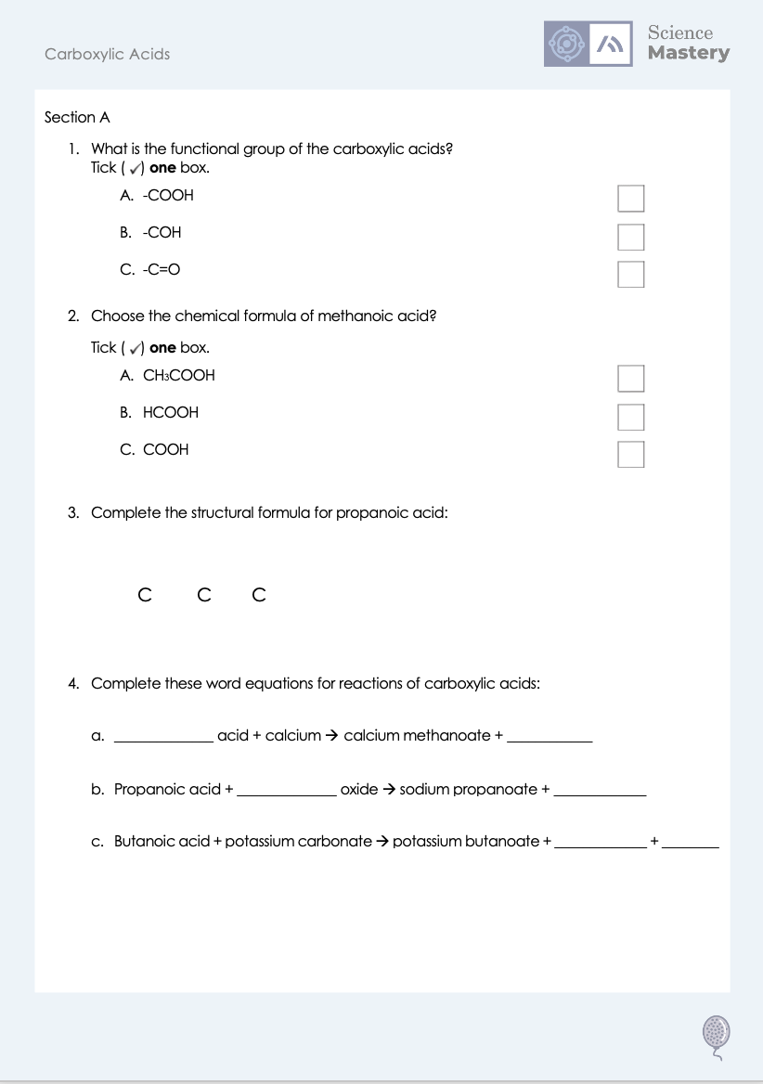
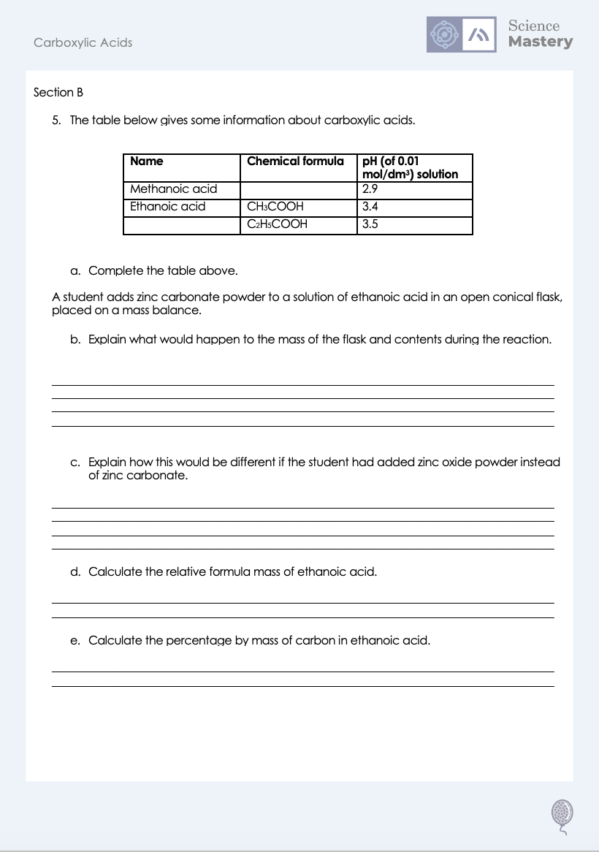
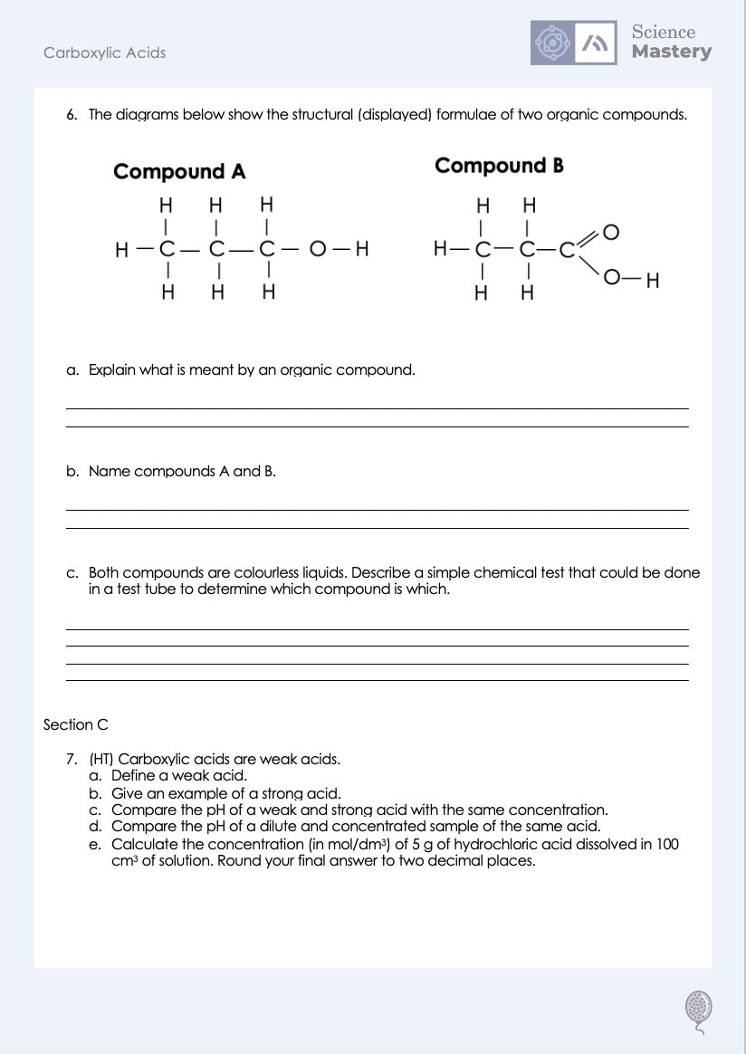
Worksheet

Slide 22
Answers
1. A -COOH
2. B - HCOOH
3.
H
H
O
H
C
C
C
O
H
H
H
4a. Methanoic acid + calcium → calcium methanoate + hydrogen
4b. Propanoic acid + sodium oxide → sodium propanoate + water
4c. Butanoic acid + potassium carbonate → potassium butanoate + water + carbon dioxide

Slide 23
Answers
5a.
Name | Chemical formula | pH (of 0.01 mol/dm³) solution
Methanoic acid |  | 2.9
Ethanoic acid | CH₃COOH | 3.4
 | C₂H₅COOH | 3.5
HCOOH
Propanoic acid

Slide 24
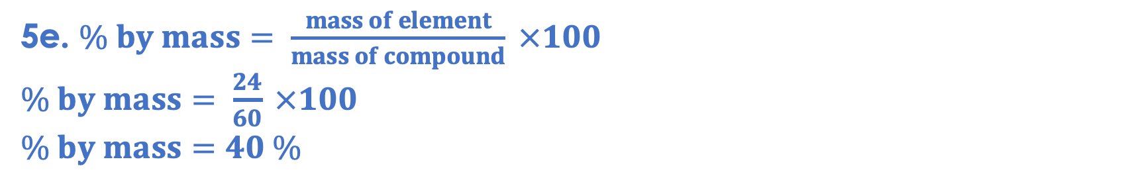
Answers
5b. The mass would decrease because carbon dioxide gas is produced, which can escape the flask.
5c. The mass would not change if zinc oxide was added instead as only the salt and water would be produced, which would not leave the flask.
5d. Mr = 12+(3x1)+12+16+16+1 = 60
5e. $\% by mass= \frac{mass of element}{mass of compound} ×100$
$\% by mass= \frac{24}{60} ×100$
$$\% by mass=40 \%$$

Slide 25
Answers
6a. A chemical compound that contains carbon atoms, chemically bonded to other atoms.
6b. Compound A: Propanol
Compound B: Propanoic acid
6c. Any of the below tests:
Add a metal carbonate, compound B would cause effervescence
Add a metal, compound B would cause effervescence
Add an indicator (e.g. Universal Indicator), compound B would show an acidic pH/orange-red colour

Slide 26
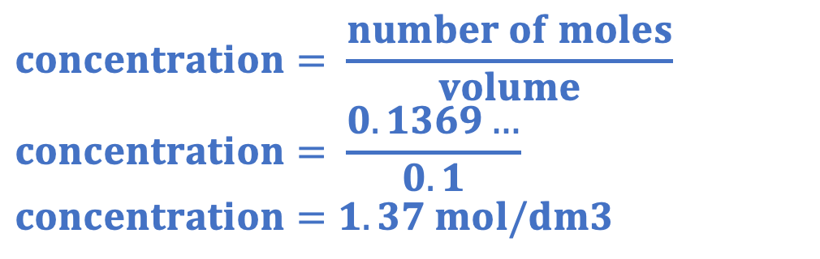
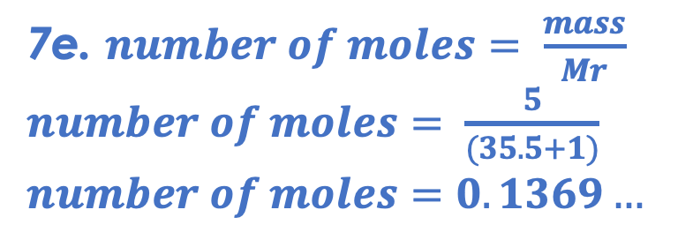
Answers
7a. An acid that only partially ionises/dissociates in solution.
7b. Hydrochloric acid, nitric acid, sulfuric acid
7c. If two acids had the same concentration, the stronger acid would have a lower pH
7d. If two acids had the same strength, the more concentrated acid would have a lower pH
$$concentration= \frac{number of moles}{volume}$$
$$concentration= \frac{0.1369…}{0.1}$$
$$concentration=1.37 mol/dm3$$
7e. $number of moles= \frac{mass}{Mr}$
$number of moles= \frac{5}{(35.5+1)}$
$$number of moles=0.1369…$$

Slide 27
Answer the questions below.
Choose the functional group found in carboxylic acids.
A. Hydroxyl group
B. Carboxyl group
C. Carboxylate group
✓
Which carboxylic acid has the formula CH₃COOH?
A. Methanoic acid
B. Ethanoic acid
C. Propanoic acid
✓
What are the products of a reaction between a carboxylic acid and a metal carbonate?
A. A salt, water and carbon dioxide
B. A salt, water and hydrogen
C. A salt and water
✓
Notes:
Q1. Answer: B
If students answer A, they have confused the functional groups of the alcohols and carboxylic acids. If students answer C, they have confused the naming of salts with the functional group, which is also a common mistake. To fix-it, review the names and formulae of functional groups from different homologous series.
Q2. Answer: B
If students answer A, they have made the common mistake of ignoring the carbon from the functional group. If students answer C, they are not secure with the naming convention prefixes for organic compounds. To fix it, review the prefixes used for different numbers of carbon atoms and give students practice identifying and drawing their displayed formulae.
Q3. Answer: A
If students answer B or C, they have not identified the products of acid and carbonate reactions. To fix it, review the general equations for reactions between acids and metals, acids and alkalis and acids and metal carbonates.

Slide 28
Lesson C5.1.10
What was good about this lesson? | What can we do to improve this lesson?
Send us your feedback by clicking this link
or by emailing sciencemastery@arkonline.org
Thank you!

